Slide 1
DENOSUMAB MEDICAL

Slide 2
Outline
Section 1 : Anatomy & Physiology
Bone Anatomy
Vitamin D3 and Calcium
Bone Remodeling
Bone Signaling & RANKL
Section 2 : Pathophysiology
Functions of bone
Molecular Composition
Cancer & Bone
Prostate Cancer Type
Hormonal Therapy for Prostate cancer & Risk Factor in bone development
Osteoporosis
Screening of Osteoporosis : DEXA & T Score
Prostate Cancer and Osteoporosis
Section 3: Treatment Options
Difference Between Anabolic Vs Antiresorptive Agents
Treatment for Osteoporosis
Medications
MAB’s
OUTLINE
Section 4: Denosumab Rx Information
Description & Key Facts
Indications
Contraindications
Warning and precautions
Adverse Reaction
Section 5: Guidelines & Recommendations
Section 7: Clinical Overview
MOA : Denosumab
MOA: Denosumab Vs Bisphosphonates
Dosage & Administration
PK/PD
Use in Specific population
Over Dosage
Key differences : bisphosphonates Vs Denosumab
Section 6: Place in therapy
Section 8 : FAQ

Slide 3
Denosumab
Section 1: Anatomy & Physiology

Slide 4
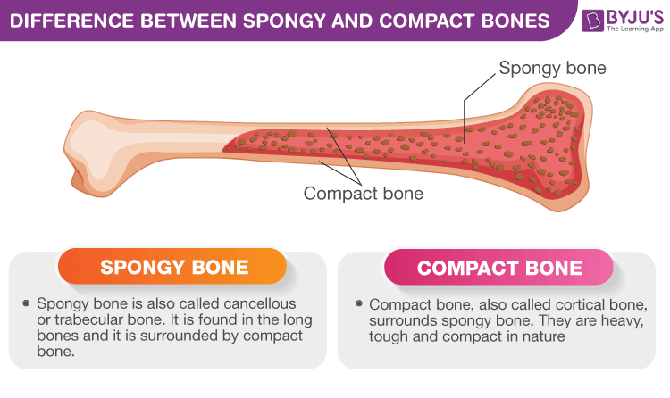
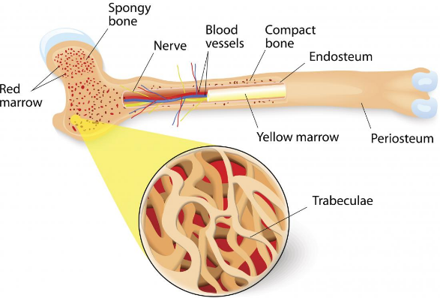
Bone Anatomy
Bones are composed of two types of tissue:
Compact (cortical) bone:
Cancellous (trabecular or spongy) bone:
A hard outer layer that is dense, strong, and durable.
This consists of a network of trabeculae or rod-like structures.
Makes up around 80 % of adult bone mass.
lighter, less dense, and more flexible than compact bone

Slide 5
Function of Bones
Support | Bones provide a framework that supports the body and cradles its soft organs.
Protection | The fused bones of the skill protect the brain. The vertebrae surround the spinal cord, and the rib cage protects the vital organs of the thorax.
Anchorage | Skeletal muscles, which attach to the bones by tendons, use bones as levers to move the body and its parts.
Blood Cell Formation | Most blood cell formation, or haematopoiesis, occurs in the red marrow cavities of certain bones.
Allows Mineral and Growth factor storage | Bone is a reservoir for minerals, most importantly calcium and phosphate. Stored minerals are released into the bloodstream in their ionic form as needed for distribution to all parts of the body.
Triglyceride (Fat) storage | Fat, a source of energy for the body, is stored in bone cavities.
Hormone production | Bones produce osteocalcin, a hormone that helps to regulate insulin secretion, glucose homeostasis, and energy expenditure.
https://quizlet.com/148364378/seven-important-functions-of-bones-flash-cards/

Slide 6
Bone
Cells
Osteoblast
Osteoclast
Osteocyte
Matrix
Organic Compounds
Collagen
Non Collagenous
Inorganic Compounds
Calcium
Phosphate
Carbonate
Sodium
Magnesium
Potassium
Osteopontin
Osteonectin
Bone Sialoprotein
Osteocalcin
Proteoglycans
(67%)
(33%)
(28%-30%)
(5%-7%)
(39%) (17%) (9.8%) (0.7%) (0.5%) (0.2%)

Slide 7
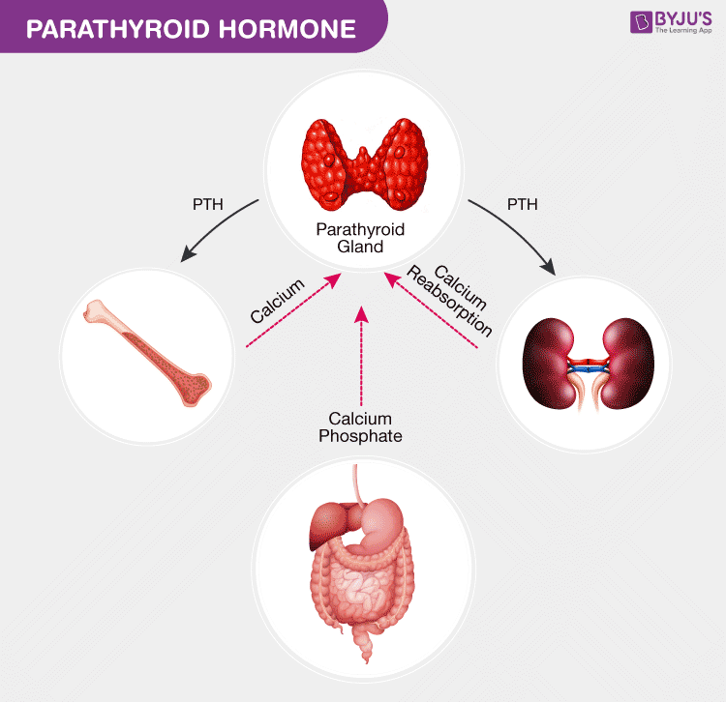
Parathyroid Hormone PTH
PTH Causes
Bones to release Calcium in Blood stream (Increase Osteoclast)
increases the calcium absorption in the intestine by food through its impacts and affects the metabolism of vitamin D
Minimizes the calcium loss in the urine and also stimulates active vitamin D formation in the kidneys.

Slide 8
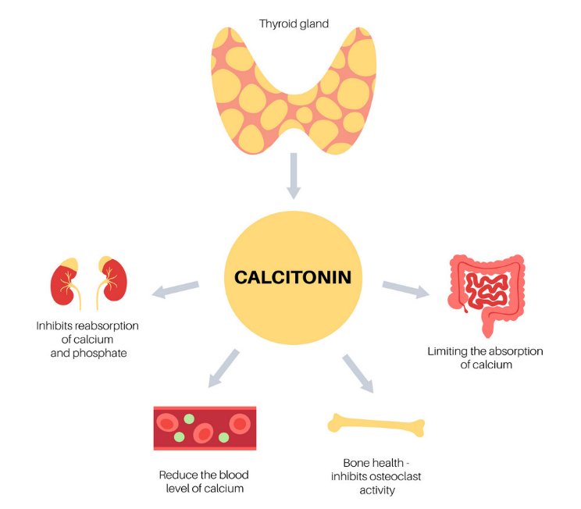
Calcitonin Causes
Bones to inhibit osteoclast Activity
Decrease in Intestinal Absorption of calcium
Inhibits reabsorption of calcium and phosphate
Reduce overall blood calcium level
https://www.hyperparathyroidmd.com/calcitonin-and-the-parathyroid-hormone/

Slide 9
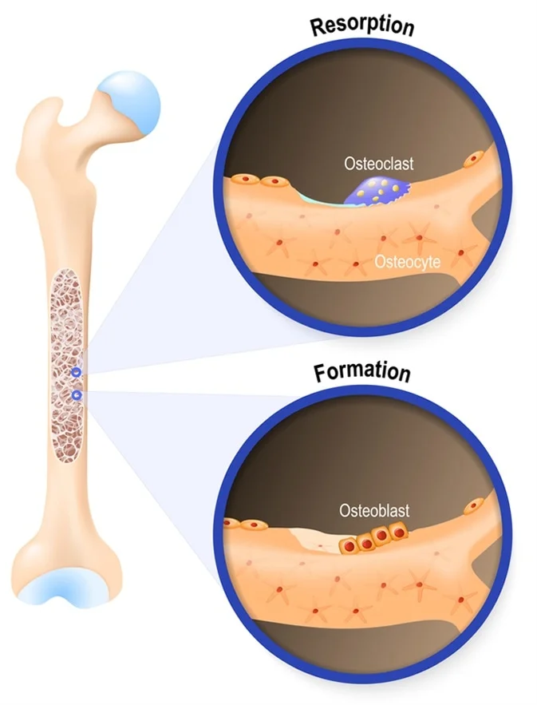
Bone Metabolism
Osteoclast
Bone metabolism is a dynamic process that balances bone formation and bone resorption
Bone Resorption
Performed by Active Osteoclast and Stimulated by RANKL (Normal Process)
Stimulated by PTH in pathologic process
(Metastatic disease)
Bone Formation
Stimulating osteoblasts and Inhibiting osteoclasts
Osteoblast
https://www.orthobullets.com/basic-science/9010/bone-signaling-and-rankl

Slide 10
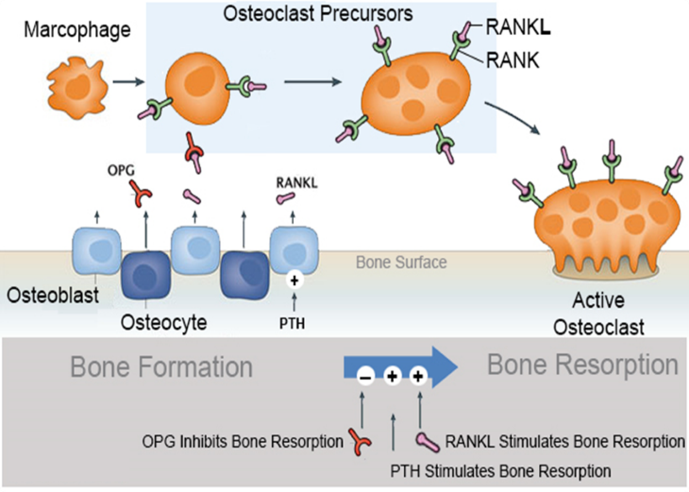
Bone Signaling & RANKL
Osteoblast Produces RANKL and OPG.
RANKL Binds to RANK on Stimulates Osteoclastic bone resorption
This is called Osteoclast activation or Active Osteoclast
OPG Inhibits Osteoclast process
Osteoclast Inhibition decreases bone resorption
Leads to increase in Bone formation
RANKL: Receptor activator of nuclear factor kappa-Β ligand (protein)
OPG: osteoprotegerin (regulatory Factor)
https://www.orthobullets.com/basic-science/9010/bone-signaling-and-rankl

Slide 11
Osteoclast Activation & Inhibition.
OSTEOCLAST ACTIVATION
OSTEOCLAST INHIBITION
Molecules that stimulate bone resorption
RANKL
PTH
interleukin 1 (IL-1)
1,25 dihydroxy vitamin D
prostaglandin E2
IL-6 (myeloma)
MIP-1A (myeloma)
Molecules that inhibit bone resorption
Oosteoprotegerin (OPG)
Calcitonin
Estrogen
Inhibits activation of adenylyl cyclase
transforming growth factor beta (TGF beta)
Interleukin 10 (IL-10)
https://www.orthobullets.com/basic-science/9010/bone-signaling-and-rankl

Slide 12
Denosumab
Section 2: Pathophysiology

Slide 13
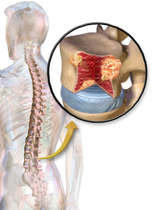
Cancer and Bone
Individuals may be at risk for serious bone problems if diagnosed with
Breast,
Prostate, or
Other types of solid tumours (cancer) with bone metastases

Slide 14
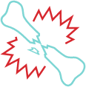



What are serious bone problems that can arise?
When your bones are weakened by cancer, you are at risk for serious bone problems, which are:
A need for radiation treatments to the bone
Pressure on the spinal cord (compression)
Broken bones (fractures)
A need for bone surgery

Slide 15
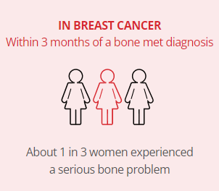
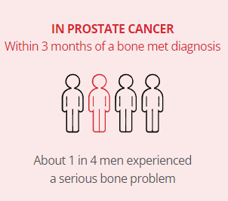
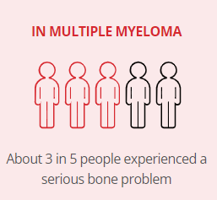
Cancer and Bone Prevalence
SOLID
TUMOR
MULTIPLE MYELOMA
https://www.Denosumab.com/why-bones-matter

Slide 16
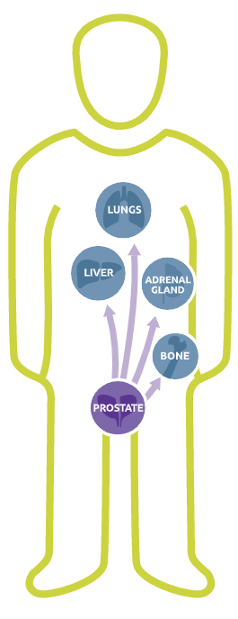

Types Of Prostate Cancer
What is mCSPC?
Prostate cancer that HAS SPREAD to other parts of the body and STILL responds to a medical or surgical treatment that lowers testosterone.
This is called metastatic castration-sensitive prostate cancer or mCSPC.
What is HRPC ?
prostate cancer that is NO LONGER RESPONDS to any type of hormone therapy, including the newer medicines.

Slide 17



Types Of Prostate Cancer
What is mCRPC?
Prostate cancer that HAS SPREAD to other parts of the body and NO LONGER responds to a medical or surgical treatment that lowers testosterone.
This is called non-metastatic castration-resistant prostate cancer or nmCRPC.
What is nmCRPC?
Prostate cancer that HAS NOT SPREAD to other parts of the body and NO LONGER responds to a medical or surgical treatment that lowers testosterone.
This is called non-metastatic castration-resistant prostate cancer or nmCRPC.
https://www.ncbi.nlm.nih.gov/pmc/articles/PMC5378096/

Slide 18
Hormone Therapy for Prostate Cancer
Hormone therapy is also called androgen suppression therapy (AST) or Androgen Deprivation therapy (ADT)
The goal is
To reduce levels of male hormones, called androgens, in the body, or
To stop them from fueling prostate cancer cells.
Androgens stimulate prostate cancer cells to grow.

Slide 19
Hormone Therapy for Prostate Cancer Contd…
The main androgens in the body are
Testosterone and
Dihydrotestosterone (DHT).
Most androgens are made by the testicles, but the adrenal glands as well as the prostate cancer itself, can also make a fair amount.
Lowering androgen levels or stopping them from getting into prostate cancer cells often makes prostate cancers shrink or grow more slowly for a time.
But hormone therapy alone does not cure prostate cancer.

Slide 20
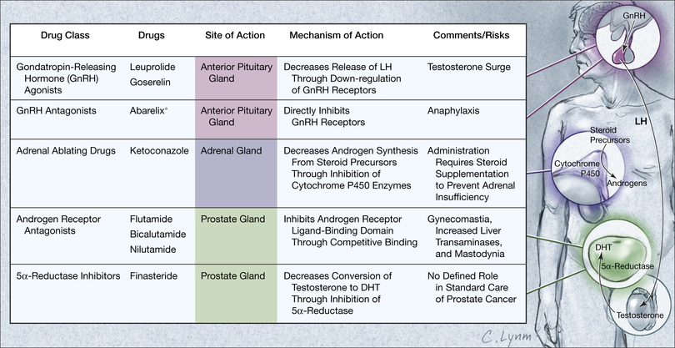
Hormonal Treatment Site for Prostate Cancer

Slide 21
Hormonal Treatment to lower androgen levels in prostate cancer
Treatment to lower testicular androgen levels
Orchiectomy
LHRH agonists
LHRH antagonists
Treatment to lower androgen levels from the adrenal glands
Abiraterone
Ketoconazole
Drugs that stop androgens from working
Anti-androgens
Other androgen-suppressing drugs
Estrogens
New Anti-androgens
Surgical Castration
Leuprolide, Goserelin, Triptorelin, Leuprolide Mesylate
Degarelix , Relugolix
Flutamide ,Bicalutamide, Nilutamide
Enzalutamide, Apalutamide

Slide 22
How does ADT put men with nonmetastatic prostate cancer at high risk for fracture?
Among Men with Nonmetastatic Prostate Cancer
Androgen deprivation therapy(ADT) can result in bone loss and is associated with fracture risk.^{3,4}
3. J Natl Compr Canc Netw. 2013;11(Suppl 3):S1–S50
4.J Clin Endocrinol Metab. 2005;90:6410-6417
3. Gralow JR, Biermann JS, Farooki A, et al. NCCN task force report: bone health in cancer care. J Natl Compr Canc Netw. 2013;11(Suppl 3):S1–S50. 4. Greenspan SL, Coates P, Sereika SM, Nelson JB, Trump DL, Resnick NM. Bone loss after initiation of androgen deprivation therapy in patients with prostate cancer. J Clin Endocrinol Metab. 2005;90:6410-6417

Slide 23
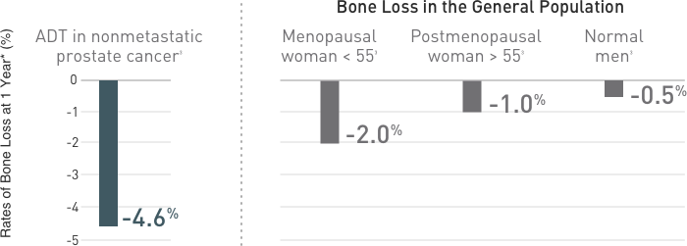
Bone Mineral Density (BMD): Comparison of ADT-induced BMD loss vs normal BMD loss in men and women^{3,4}
4.J Clin Endocrinol Metab. 2005;90:6410-6417
Patients with prostate cancer receiving ADT lost up to 4% BMD at the posteroanterior spine in the first year of therapy alone.⁴
Calcium and vitamin D supplementation alone may not be sufficient to prevent bone loss and fractures in patients receiving ADT.⁸
Reference data are obtained from population-based or review articles that measured bone loss at different sites (eg, lumbar spine or total hip).3,8
3Gralow JR, Biermann JS, Farooki A, et al. NCCN task force report: bone health in cancer care. J Natl Compr Canc Netw. 2013;11(Suppl 3):S1–S50.
4. Greenspan SL, Coates P, Sereika SM, Nelson JB, Trump DL, Resnick NM. Bone loss after initiation of androgen deprivation therapy in patients with prostate cancer. J Clin Endocrinol Metab. 2005;90:6410-6417
8. Higano CS. Androgen-deprivation-therapy-induced fractures in men with nonmetastatic prostate cancer: what do we really know? Nat Clin Pract Urol. 2008;5:24-34

Slide 24
Fracture: Percent of patients with a fracture, 12 to 60 months after diagnosis of prostate cancer
STUDY: SEER & MEDICARE DATA BASE : Data from a bone-related toxic effect sub analysis (n=26,685)
Men diagnosis of prostate cancer over a 12- to 60-month period.
ADT included gonadotropin-releasing hormone (GnRH) agonist therapy or orchiectomy.⁹
Data have shown that nearly 1 in 5 men receiving multiple doses of ADT experienced a fracture within 4 years after the first year of diagnosis.⁹
Patients with prostate cancer receiving ADT experienced a 54% increase in relative incidence of fractures compared with patients not receiving ADT.⁹
Calcium and vitamin D supplementation alone may not be sufficient to prevent bone loss and fractures in patients receiving ADT.⁸
9. N Engl J Med. 2005;352:154-164
8. Nat Clin Pract Urol. 2008;5:24-34
9. N Engl J Med. 2005;352:154-164

Slide 25
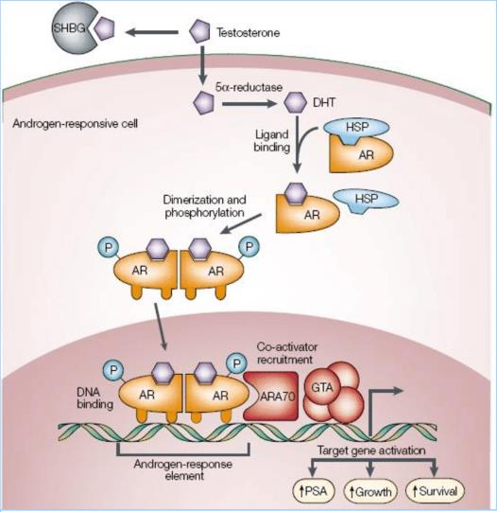
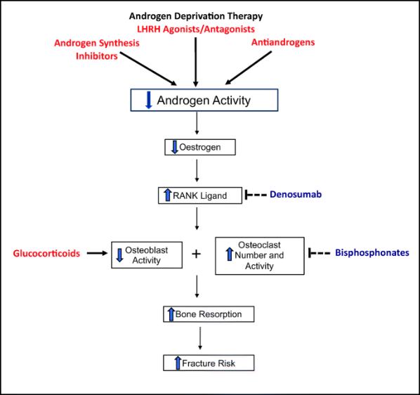
Prostate Cancer Treatment And Osteoporosis
ADT INCREASES RISK OF BONE FRACTURE AND DECREASE BONE MINERAL DENSITY

Slide 26
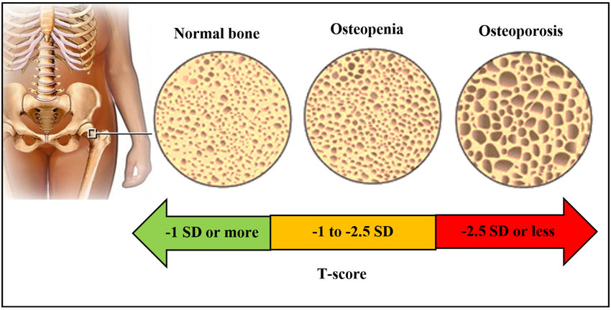
Osteoporosis
A condition in which bones become weak and brittle.
The body constantly absorbs and replaces bone tissue.
With osteoporosis, new bone creation doesn't keep up with old bone removal.

Slide 27
Risk factors for osteoporosis in Men:
Height loss of 1/2 inch or more within one year²
Advanced age
Low bone mineral density (BMD)
Family history of osteoporosis or fractures
Prior fracture
Low testosterone or estrogen levels³
1. National Osteoporosis Foundation. The Man’s Guide to Osteoporosis. Washington, DC: National Osteoporosis Foundation; 2011.
3. International Osteoporosis Foundation. Invest in your bones. Osteoporosis in men: the ‘silent epidemic’ strikes men too. https://www.iofbonehealth.org/sites/default/files/PDFs/WOD%20Reports/osteoporosis_in_men_2004_english.pdf. Accessed July 8, 2019

Slide 28
Denosumab
Section 3: Treatment Option

Slide 29
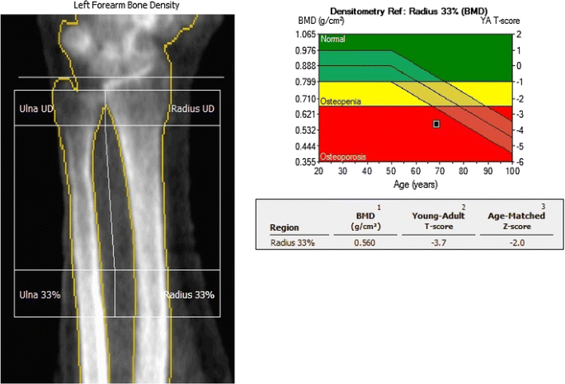
Osteoporosis Screening: DEXA Scan Dual-Energy X-ray Absorptiometry
A bone density scan which can detect thinning bones at an early stage.
DEXA scores are reported as "T-scores" and "Z-scores.“
Multiplying the T-score by 10% gives a rough estimate of how much bone density has been lost.\
Z-scores are not used to formally diagnose osteoporosis
https://www.webmd.com/osteoporosis/features/tests

Slide 30
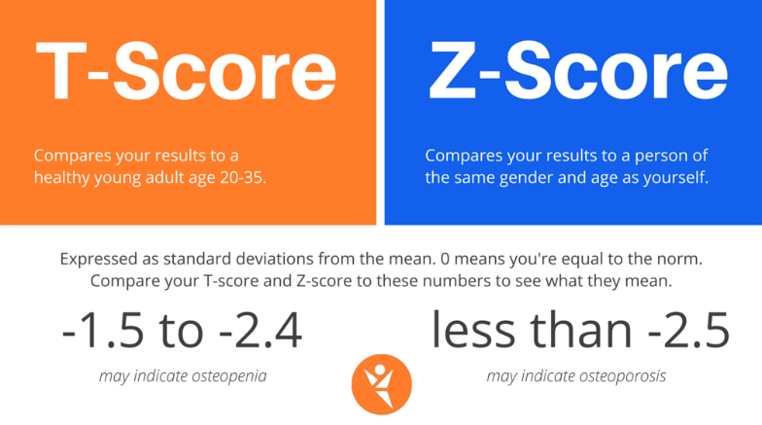
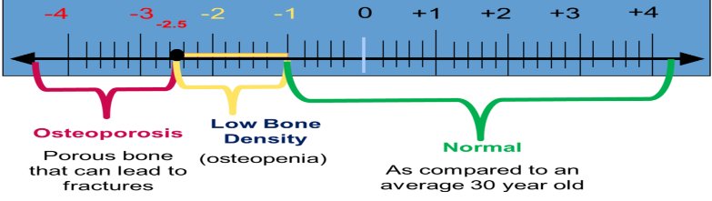
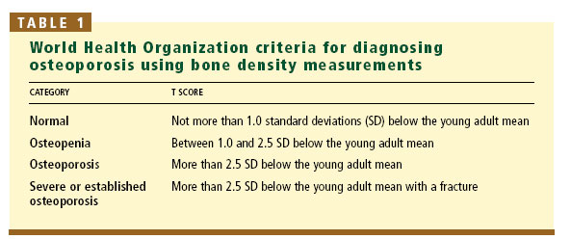
UNDERSTANDING T- SCORE The T-score is a comparison of a person's bone density with that of a healthy 30-year-old of the same sex. The Z-score is a comparison of a person's bone density with that of an average person of the same age and sex

Slide 31
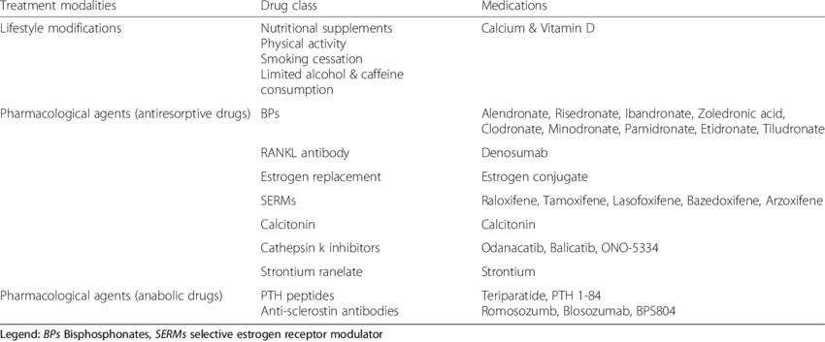
Treatment of Osteoporosis

Slide 32
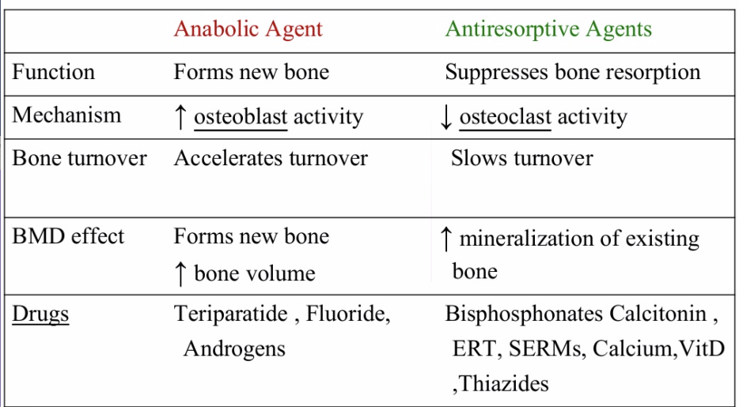
Difference Between Anabolic Vs Antiresorptive Agents

Slide 33
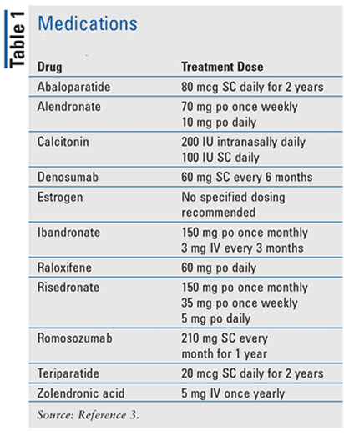
Medication for osteoporosis
BP : Zoledronic acid
Denosumab
Teriparatide
Romosozumab

Slide 34
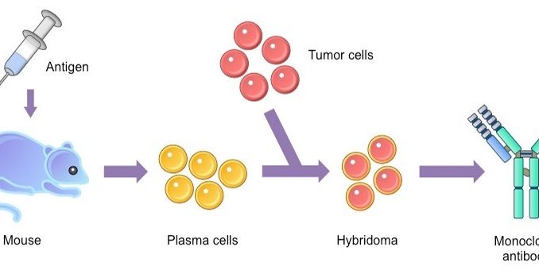
Monoclonal Antibodies
Monoclonal antibodies (also called moAbs or mAbs) are proteins made in laboratories that act like proteins called antibodies in our bodies.
Antibodies are parts of your immune system.
They seek out the antigens (foreign materials) and stick to them in order to destroy them.

Slide 35
Monoclonal Antibodies
Laboratory-made monoclonal antibodies help stimulate your own immune system.
The word “monoclonal” refers to the fact that the antibodies created in the laboratory are clones.
They are exact copies of one antibody.
Denosumab is a fully human monoclonal antibody
https://youtu.be/dxnjAc-rqz8

Slide 36
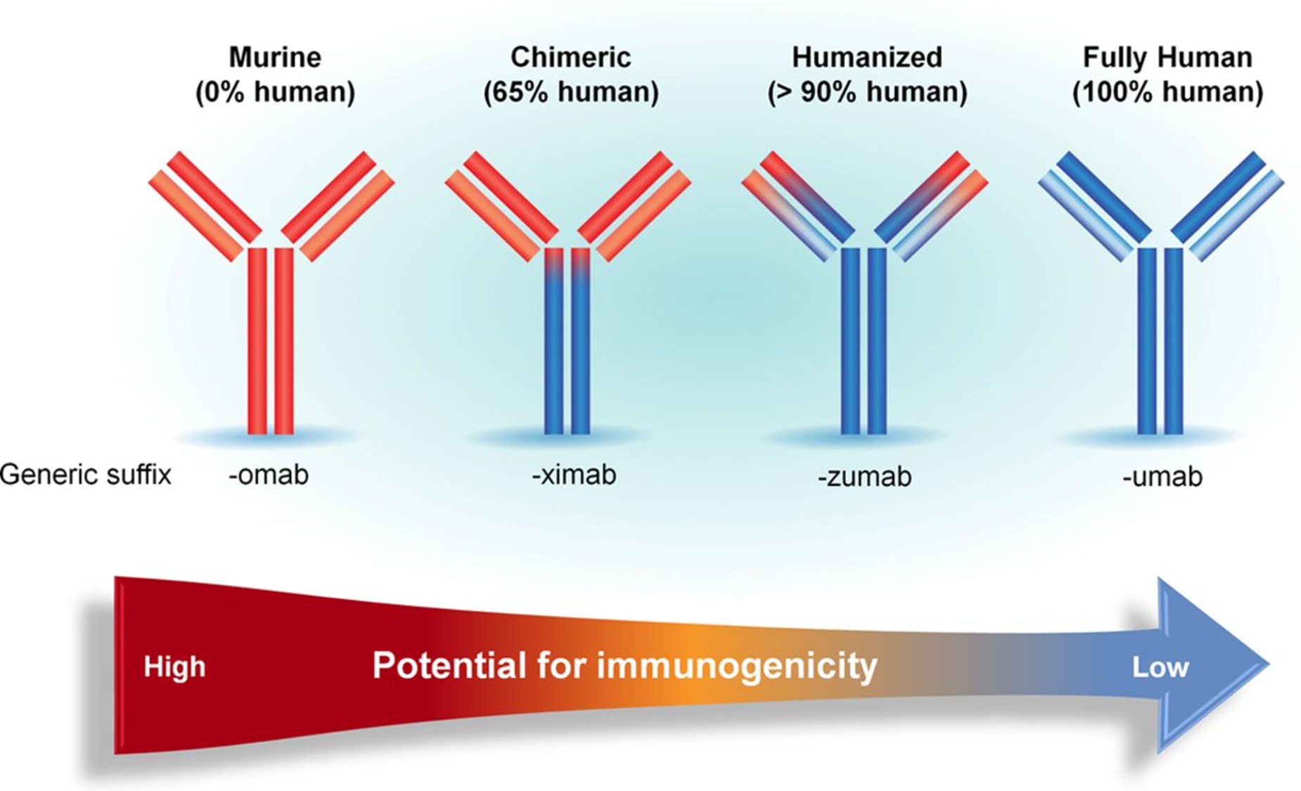
DENSOUMAB

Slide 37
Denosumab
Section 4: Prescription Information

Slide 38
Key Facts
MAB:
1st MAB Approved for treatment of Osteoporosis
MOA:
RANKLi (receptor activator of nuclear factor kappa-Β ligand)
CLASS: Bone anti-resorptive drug
Denosumab is not chemotherapy Drug
DOSAGE:
NM Condition : 60 mg/mL every 6th Month.
M Condition: 120 mg every 4 wk subcutaneous injection
INDICATION:
Treatment to increase bone mass in men at high risk for fracture receiving androgen deprivation therapy for nonmetastatic prostate cancer
Treatment of Men with osteoporosis at high risk for fracture

Slide 39
Approved Indication
Jun 1, 2010
Sep 19, 2011
Sep 21, 2012
May 21, 2018
Nov 19, 2010
Jun 13, 2013
Dec 8, 2014
Jan 5, 2018
For treatment of postmenopausal women with osteoporosis at high risk for fracture
Treatment of bone loss in patients with prostate or breast cancer undergoing hormone ablation therapy
For the treatment of bone loss in men with osteoporosis at high risk for fracture
For glucocorticoid-induced osteoporosis
Prevention of skeletal-related events in patients with bone metastases from solid tumor
To treat giant cell tumor of the bone
Hypercalcemia of malignancy refractory to bisphosphonate therapy
For the prevention of skeletal-related events in patients with multiple myeloma
C
C
C
C
C

Slide 40
Focused Indication
Treatment to increase bone mass in men at high risk for fracture receiving androgen deprivation therapy (ADT) for nonmetastatic prostate cancer
For the treatment of bone loss in men with osteoporosis at high risk for fracture

Slide 41
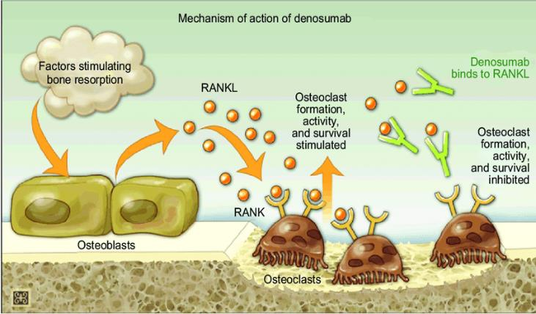
MOA
Denosumab is a monoclonal antibody that is fully human and was approved by the FDA as the first RANKL inhibitor.
RANK is activated by the ligand RANKL, which is present on the cell surface of osteoblasts.
By activating RANK, RANKL promotes the development of pre-osteoclasts into active osteoclasts.
Denosumab binds to RANKL and inhibits it, inhibiting the formation of osteoclasts.
This reaction protects the bone from resorption by mimicking the natural activity of OPG.

Slide 42
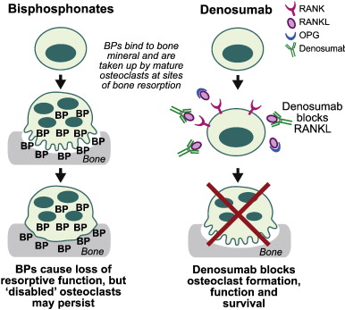
MOA for Denosumab and bisphosphonates
Denosumab is a more potent bone resorption inhibitor than BP.
When Denosumab medication is stopped, the suppression of bone turnover is quick and completely reversed.
Denosumab prevents RANKL from binding to its receptor, RANK, thereby inhibiting the development, activation, and survival of osteoclasts.
This is different from the mechanism of action of bisphosphonates, which bind to bone mineral and probably inhibit osteoclast function mainly by being taken up by osteoclasts at sites of bone resorption

Slide 43
Key differences between and bisphosphonates and denosumab
FEATURE | BISPHOSPHONATES | DEBRUMAB
Effect on osteoclast¹ | Induce apoptosis; | Inhibits osteoclast formation, function, and survival rapid onset of action
Nephrotoxicity | IV bisphosphonates have a higher risk of side effects than oral bisphosphonates, including nephrotoxicity | Denosumab does not cause nephrotoxicity.
Dose Adjustment (Renal Patients) | Required | No dose adjustment is necessary in patients
Pill Esophagitis | Oral bisphosphonates should be avoided in patients with esophageal emptying disorders or who are unable to sit upright, because these patients are at high risk for pill esophagitis | No such Disorder
Acute Phase Response | Seen almost 3 times more frequently with intravenous bisphosphonates than with denosumab. | Seen 3 times less frequently with denosumab compared to bisphosphonates.
Dosing | Once Daily , Once weekly (oral) | Once every 6th Month (Injection)
Int J Clin Pract. 2012 Dec; 66(12): 1139–1146.

Slide 44
Key differences between and bisphosphonates and denosumab
FEATURE | BISPHOSPHONATES | DEBRUMAB
First Pass Effect | Undergoes First pass metabolism | Subcutaneous injection. Does not undergo first-pass metabolism²
Pill Burden | Increased pill Burden | Reduced Pill Burden
Onset Of Action | Depends on Types of bisphosphonates and length of Treatment | Rapid Onset Of Action
Adherence¹ | Counsel on adherence Consider difficulties around dosing: - Must be taken with 6–8 oz plain water at least 30 minutes before first food/drink/ medication\ - Potential for esophagitis - Calcium supplements/antacids can interfere with absorption | No Counsel on Adherence required
First Pass Metabolism | As Oral Drug It undergoes First Pass metabolism | As a subcutaneous injection, does not undergo first-pass metabolism
1. JNCCN—Journal of the National Comprehensive Cancer Network | Volume 11 Supplement 3 | August 2013
2. Turner PV, Brabb T, Pekow C, Vasbinder MA. Administration of substances to laboratory animals: routes of administration and factors to consider. J Am Assoc Lab Anim Sci. 2011;50:600–613

Slide 45
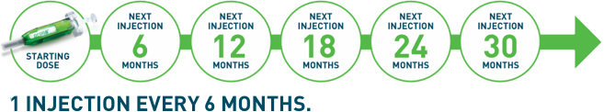
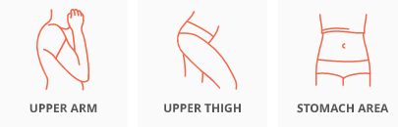
Dosage Form
60 mg/mL solution in a single-dose prefilled syringe.
+ Calcium 1000 mg daily and at least 400 IU vitamin D daily
Administered as 1 shot every 6 months¹
60 mg subcutaneous injection in the upper arm, upper thigh, or abdomen

Slide 46
Dosage : Solid Tumor including Metastatic Prostate cancer related Osteoporosis
120 mg every 4 weeks as a subcutaneous injection in the upper arm, upper thigh, or abdomen
No dose adjustment is necessary in patients with renal impairment, but Calcium & D3 Monitoring is must in severe Renal impairment

Slide 47
Dosage
Pre-existing hypocalcemia must be corrected prior to initiating therapy with Denosumab
Adequately supplement all patients with calcium and vitamin D
Multiple vertebral fractures have been reported following Denosumab discontinuation
As a subcutaneous injection, Denosumab does not undergo first-pass metabolism¹
May lessen patient pill burden
Turner PV, Brabb T, Pekow C, Vasbinder MA. Administration of substances to laboratory animals: routes of administration and factors to consider. J Am Assoc Lab Anim Sci. 2011;50:600–613

Slide 48
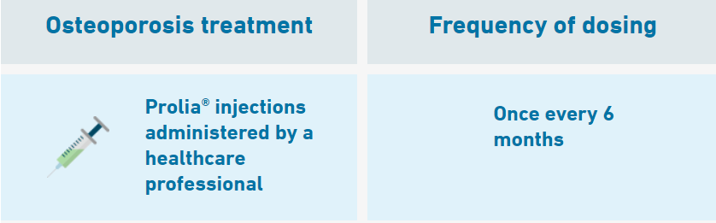
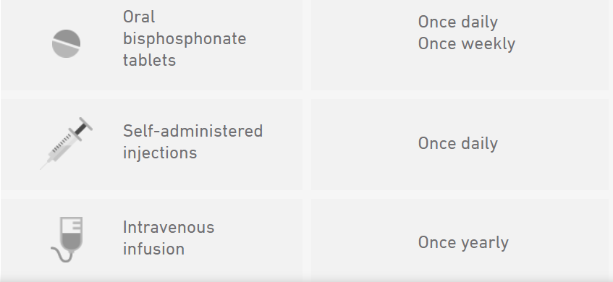
Dosing Benefit: Denosumab requires fewer doses than most other osteoporosis treatments indicated for men
Dose Adjustment:
No dose adjustment is necessary in patients with renal impairment, Patients.
However Calcium & D3 Monitoring is must in severe Renal impairment
Denosumab Inj is
Prolia.com

Slide 49




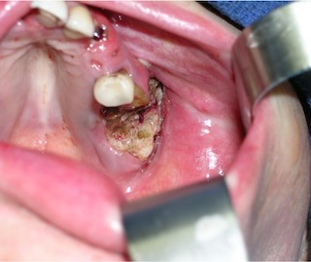
Information Essential To Safe Dosing Or Administration
BEFORE ADMINISTATION
AFTER ADMINISTATION
Calcium level check
Dental evaluation
Set up routine appointments
Take calcium and vitamin D supplements for extra prevention
https://www.Denosumab.com/start-treatment#Getting-Started

Slide 50
Contraindications
Hypocalcemia: Pre-existing hypocalcemia must be corrected prior to initiating therapy with Denosumab
Hypersensitivity: Denosumab is contraindicated in patients with a history of systemic hypersensitivity to any component of the product.
Reactions have included
Anaphylaxis
Facial swelling, and
Urticaria

Slide 51
Adverse Reaction:
The following serious adverse reactions are discussed below and also elsewhere in the labelling:
Hypocalcemia
Serious Infections
Dermatologic Adverse Reactions
Osteonecrosis of the Jaw
Multiple Vertebral Fractures (MVF) Following Discontinuation of Denosumab Treatment

Slide 52
Use in specific populations
Pregnancy: Based on animal data, may cause fetal harm.
Nursing mothers: May impair mammary gland development and lactation. Discontinue drug or nursing
Pediatric patients: Safety and efficacy not established
Renal impairment: No dose adjustment is necessary in patients with renal impairment. Patients with creatinine clearance < 30 mL/min or receiving dialysis are at risk for hypocalcemia. Supplement with calcium and vitamin D and consider monitoring serum calcium

Slide 53
Overdosage.
There is no experience with overdosage with Denosumab .

Slide 54
DEBRUMAB FEATURES & BENEFITS
POINTS | FEATURES | BENEFITS
Nephrotoxicity¹ | Denosumab does not cause nephrotoxicity. | Can be administered to Renal patient. No dose adjustment is necessary in patients with renal impairment.
Pill Esophagitis² | No Pill-Induced Esophagitis | Densoumab can be easily given to patients with esophageal emptying disorders or who are unable to sit upright,
Adherence² | No Counselling on Adherence required | Better Patient Compliance
Dosing³ | Once every 6th Month (Injection) | Better Patient Compliance
Infusion Chair³ | No Infusion Chair Needed | Better Patient Compliance
Pill Burden³ | Reduced Pill Burden | Better Patient Compliance
First Pass Effect³ | Does not Undergoes First pass metabolism since it is a subcutaneous Injection | More efficacy and can potentially be used in patients with more advanced renal dysfunction
Route of Administration^{3,4} | The first and only BTA administered subcutaneously | Convenient subcutaneous administration that may complement a patient’s primary treatment regimen
Mechanism of action⁵ | only BTA that blocks the function of RANKL | More effective than ZA in inhibiting osteoclastic activity. Better Result
Int J Clin Pract. 2012 Dec; 66(12): 1139–1146
Volume 11 Supplement 3 JNCCN
3. Denosumab prescribing information
zoledronic acid prescribing information
Eur J Cancer. 2012;48(16):3082-3092.

Slide 55
Denosumab
Section 5: Guidelines & Recommendations

Slide 56
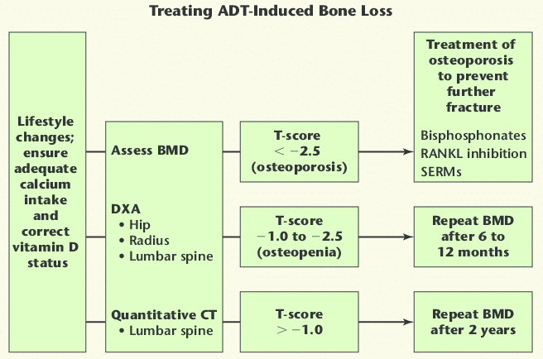
Treatment Algorithm: ADT Induced Bone Loss
Denosumab
VOL. 9 NO. 4 2007 REVIEWS IN UROLOGY

Slide 57
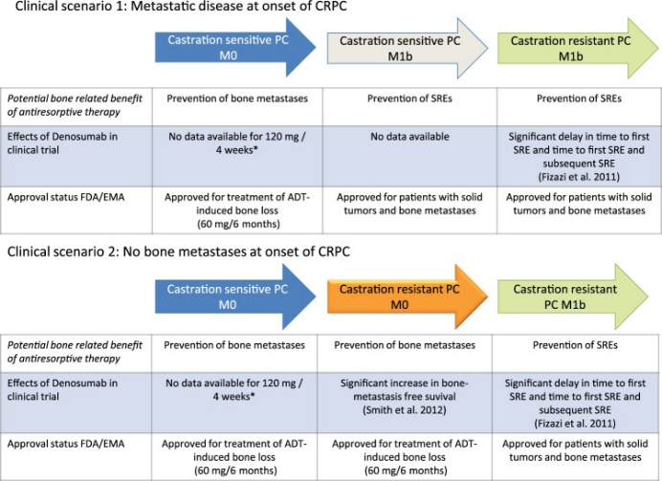
https://www.ncbi.nlm.nih.gov/pmc/articles/PMC5378096/
Ther Adv Urol. 2017 Mar-Apr; 9(3-4): 81–88

Slide 58
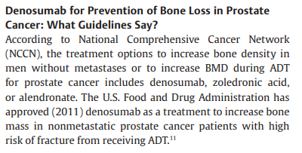
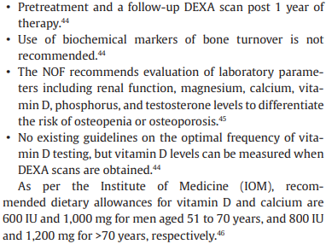
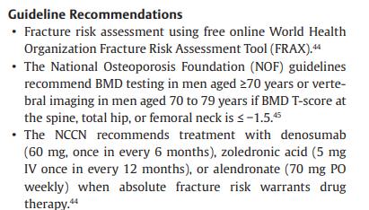
Indian Journal of Medical and Paediatric Oncology Vol. 42 No. 3/2021

Slide 59
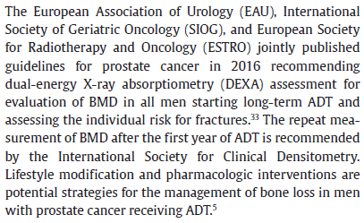
Screening Guidelines

Slide 60


Guidelines : Non Metastatic Condition

Slide 61
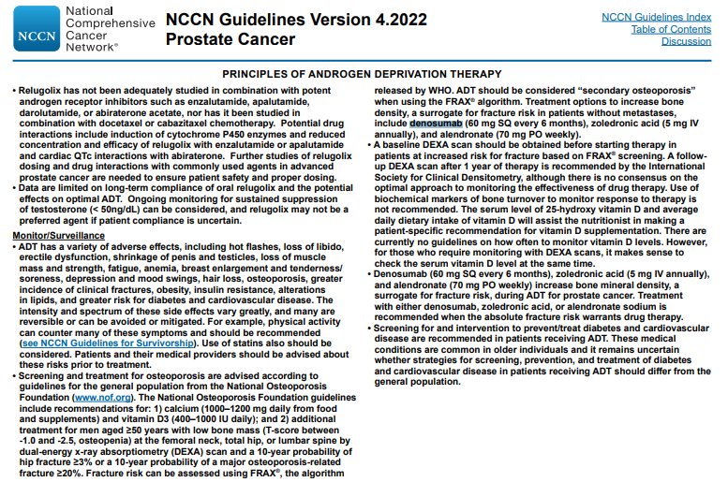

Slide 62
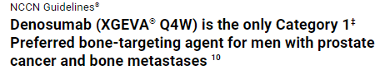
Guidelines : Metastatic Condition
Denosumab

Slide 63


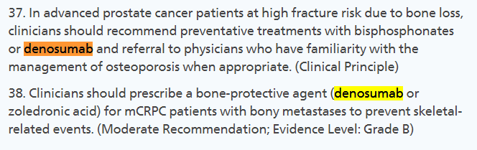
Guidelines

Slide 64
Summary:
NCCN Guideline:
60mg / 6 month Treatment of men with risk of bone fracture due to ADT treatment for Non metastatic prostate cancer and to increase the BMD.
120mg every four week for for men with metastatic prostate cancer
AUA/ASTRO/SUO Guideline:
In advanced Prostate cancer patients at high risk fracture due to bone loss.
For mCRPC patients with bony metastasis to prevent skeletal related events

Slide 65
Denosumab
Section 6: Place in therapy

Slide 66
US FDA approved Indication # 1 Treatment Of Bone Loss In Men Receiving Androgen Deprivation Therapy For Prostate Cancer
US FDA | Clinical data *
Treatment to increase bone mass in men at high risk for fracture receiving androgen deprivation therapy for nonmetastatic prostate cancer | Histologically confirmed prostate cancer
 | Receiving androgen-deprivation therapy (bilateral orchiectomy or GnRH-agonist therapy) with an expected duration of such treatment for 12 or more months
 | Low bone mineral density (T score at the lumbar spine, total hip, or femoral neck of less than −1.0) at baseline or a history of an osteoporotic fracture
 | Eastern Cooperative Oncology Group performance status score of 2 or less.
* N Engl J Med. 2009 Aug 20; 361(8): 745–755.

Slide 67
US FDA approved Indication # 2 Treatment To Increase Bone Mass In Men With Osteoporosis
US FDA | Endocrine Society Clinical Practice Guideline 2012 | Clinical data (ADAMO trial) *
Men with osteoporosis | Hip or vertebral fracture without major trauma | BMD T-score (based on male reference ranges) less than or equal to 2.0 and more than or equal to 3.5 at the LS or FN
History of osteoporotic fracture | Men who are receiving long-term glucocorticoid therapy in pharmacological doses (e.g., prednisone or equivalent 7.5 mg/d) | or had a previous major osteoporotic fracture and a BMD T-score less than or equal to 1.0 and more than or equal to 3.5 at the LS or FN
Multiple risk factors for fracture | Endocrine Society Clinical Practice Guideline 2012 | And had at least two lumbar vertebrae, one femur, and one forearm evaluable by dual-energy x-ray absorptiometry (DXA).
*J Clin Endocrinol Metab. 2012;97(9):3161–9

Slide 68
Denosumab
Section 7: Clinical Evidence

Slide 69
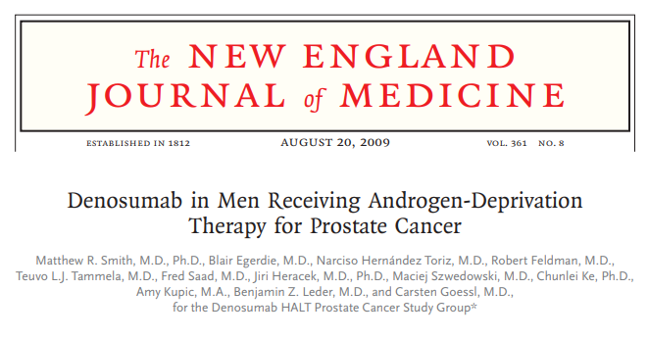
1

Slide 70
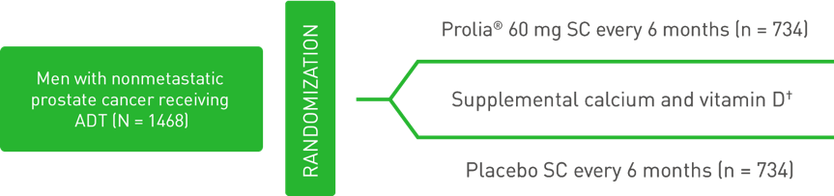
Study Design
Randomized, multinational, double-blind, phase 3 study assessing the effects of Denosumab vs placebo on BMD and new vertebral fractures
Denosumab
1. Denosumab® (denosumab) prescribing information
5. N Engl J Med. 2009;361:745-755.
6. Lancet. 2015;386(9992):433-443.

Slide 71
Inclusion Criteria:
Men were stratified according to
Duration of androgen-deprivation therapy (ADT) ( 6 months or > 6 months) and
Age ( 70 years or < 70 years).
Men less than 70 years of age had either a
BMD T-score at the lumbar spine, total hip, or femoral neck between –1.0 and –4.0, or
A history of an osteoporotic fracture.
Patients were instructed to take
1000 mg of calcium and
400 IU of vitamin D supplementation daily.
1. Denosumab® (denosumab) prescribing information
5. N Engl J Med. 2009;361:745-755.
6. Lancet. 2015;386(9992):433-443.

Slide 72
Endpoints
Primary Endpoint:
Percent change in: Lumbar spine BMD from baseline to 24 months
Secondary Endpoints:
Incidence of: Newly diagnosed vertebral fracture through 36 months
Percent change in:
Lumbar spine BMD from baseline to 36 months
Total hip BMD from baseline to 36 months
Femoral neck BMD from baseline to 36 months
1. Denosumab® (denosumab) prescribing information
5. N Engl J Med. 2009;361:745-755.
6. Lancet. 2015;386(9992):433-443.

Slide 73
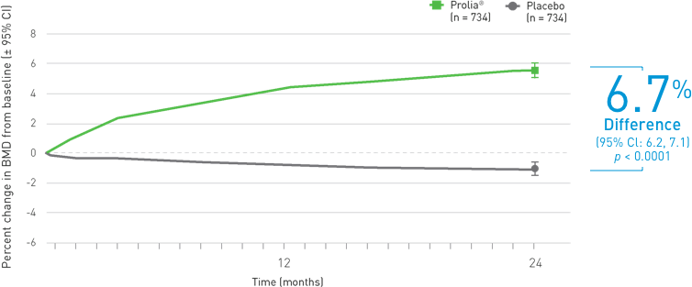
Efficacy: At 24 Month A significant increase in BMD at the lumbar spine compared with placebo (p < 0.0001; Primary Endpoint)
At 24 months, bone mineral density of the lumbar spine had increased by 5.6% in the Denosumab group as compared with a loss of 1.0% in the placebo group
The Bone Mineral Density At The Lumbar Spine Was Increased By
Mean percent change in BMD at 24 months
Denosumab
1. Denosumab® (denosumab) prescribing information
5. N Engl J Med. 2009;361:745-755.
6. Lancet. 2015;386(9992):433-443.

Slide 74
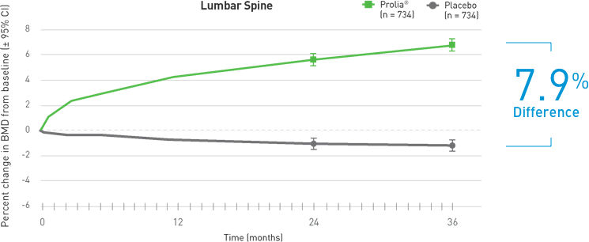
Efficacy: At 36 Months Denosumab demonstrated a continued increase in BMD through 36 months (Secondary Endpoint)
LUMBAR SPINE
Mean percent change in BMD at 36 months
1. Denosumab® (denosumab) prescribing information
5. N Engl J Med. 2009;361:745-755.
6. Lancet. 2015;386(9992):433-443.

Slide 75
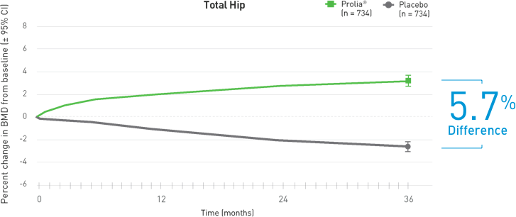
Efficacy: At 36 Months Denosumab demonstrated a continued increase in BMD through 36 months (Secondary Endpoint)
TOTAL HIP
Mean percent change in BMD at 36 months
1. Denosumab® (denosumab) prescribing information
5. N Engl J Med. 2009;361:745-755.
6. Lancet. 2015;386(9992):433-443.

Slide 76
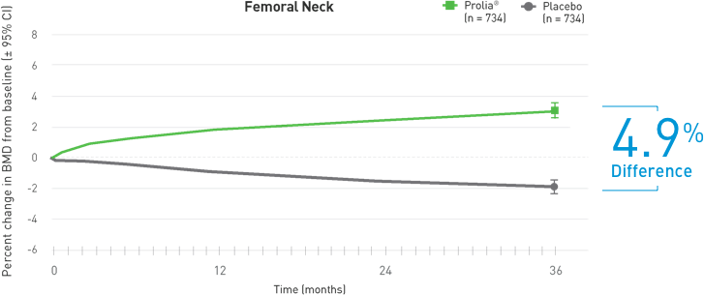
Efficacy: At 36 Months Denosumab demonstrated a continued increase in BMD through 36 months (Secondary Endpoint)
FEMORAL NECK
Mean percent change in BMD at 36 Months
1. Denosumab® (denosumab) prescribing information
5. N Engl J Med. 2009;361:745-755.
6. Lancet. 2015;386(9992):433-443.

Slide 77
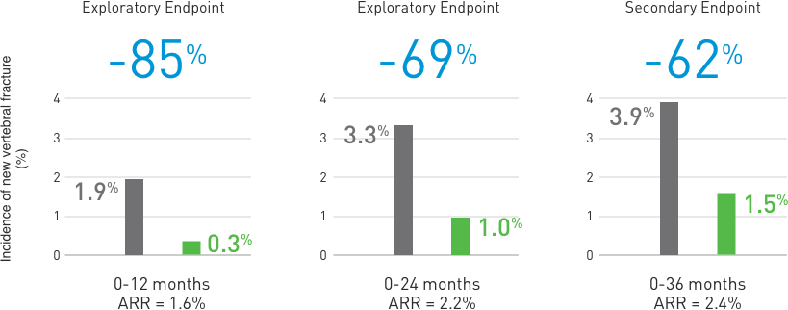
New Fracture: Denosumab sustained reduction of new vertebral fractures up to 36 months ⁶
Denosumab significantly decreased the incidence of new vertebral fractures up to 36 months ^{1,6}
Relative risk reduction of new vertebral fracture at 12, 24, and 36 months ^{1,5}
62% Relative Risk Reduction in the incidence of new vertebral fractures at 36 months* ¹
ARR = Absolute Risk Reduction.
1. Denosumab® (denosumab) prescribing information
5. N Engl J Med. 2009;361:745-755.
6. Lancet. 2015;386(9992):433-443.

Slide 78
Safety And Tolerability
Adverse Events (10% Frequency In Each Treatment Group)¹
 | Placebo (n = 725) | Denosumab (n = 731)
Arthralgia | 11.0% | 12.6%
Back pain | 10.2% | 11.1%
Constipation | 10.3% | 10.0%
Denosumab has been studied in a clinical trial of 1468 men with prostate cancer on ADT.⁵
The overall incidence of adverse events was similar between Denosumab and placebo (both approximately 87%).⁵
1. Denosumab® (denosumab) prescribing information
5. N Engl J Med. 2009;361:745-755

Slide 79
Safety And Tolerability
Pain in extremity and musculoskeletal pain have also been reported in clinical trials¹
The percentage of patients who withdrew from the study due to adverse events :
7.0% and 6.1% for the Denosumab and placebo groups, respectively¹
Overall rates of serious adverse events
34.6% and 30.6%, between Denosumab and placebo respectively¹
1. Denosumab® (denosumab) prescribing information
5. N Engl J Med. 2009;361:745-755

Slide 80
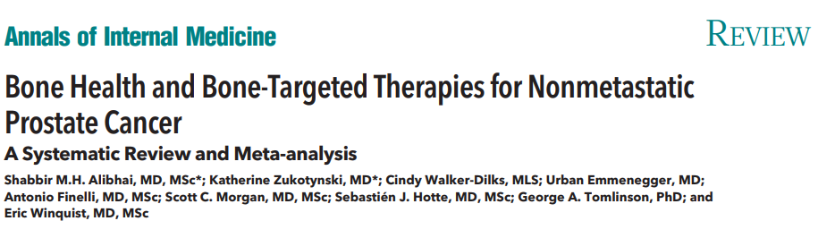
2

Slide 81
Aim
To evaluate the effectiveness of drug, supplement, and lifestyle interventions aimed at preventing fracture, improving bone mineral density (BMD), or preventing or delaying osteoporosis in men with nonmetastatic prostate cancer.
Review Ann Intern Med. 2017 Sep 5;167(5):341-350.

Slide 82

Study Design
27 trials
Men with nonmetastatic prostate cancer who were initiating or continuing androgen deprivation therapy (ADT).

Slide 83
Result
Bisphosphonates were effective in increasing BMD, but no trial was sufficiently powered to detect reduction in fractures.
Denosumab improved BMD and reduced the incidence of new radiographic vertebral fractures in 1 high-quality trial.
Conclusion: both bisphosphonates and denosumab improve BMD in men with nonmetastatic prostate cancer who are receiving ADT. Denosumab also reduces risk for radiographic vertebral fractures, based on 1 trial. More trials studying fracture outcomes are needed in this population.
Ann Intern Med. 2017 Sep 5;167(5):341-350.

Slide 84

3

Slide 85
Design:
Aim:
A network metanalysis to compare each BMA for the efcacy of bone mineral densities (BMDs) and the risk of fracture.
Primary Outcomes :
Change of BMD of the lumbar spine (LS) and the total hip (TH) from the baseline at 1 year from the initiation of the BMA
The risk of vertebral fracture.
Support Care Cancer. 2022 Jan;30(1):855-863.

Slide 86
Result:
15 studies
All BMAs except risedronate showed a significant increase of BMD of the LS
At TH, bisphosphonates (alendronate, pamidronate, and zoledronate) and denosumab showed significant elevation compared with the no-BMA group.
Denosumab was associated with the most BMD gain at the TH.
Only denosumab reduced the risk of vertebral fracture (relative risk [95% confidence interval]: 0.40 [0.20–0.81]).
Supportive Care in Cancer volume 30, pages855–863 (2022)

Slide 87
Conclusion:
Most bisphosphonates and denosumab significantly increased BMD at the LS and the TH in patients receiving ADT for prostate cancer without skeletal metastasis. In particular, zoledronate and denosumab were the most potent BMAs in terms of BMD increment at the LS and the TH, respectively. However, denosumab, not zoledronate, was the only BMA that showed a significant risk reduction of vertebral fracture
Supportive Care in Cancer volume 30, pages855–863 (2022)

Slide 88

4

Slide 89
Aim
To compare studies of men with prostate cancer receiving ADT and women with breast cancer following adjuvant endocrine therapy in order to evaluate the effects of Denosumab in terms of
BMD increase at 24 and 36 months,
The BMD loss,
The reduction of fractures risk (in particular vertebral fractures) at 24 and 36 months and
Safety (overall, serious adverse events – SAEs and discontinuation rate).
J Bone Oncol. 2019 Oct; 18: 100252.

Slide 90
Study Design
RCT’s included: 3
Trials with sample size more than 10
Prostate cancer patients
Patients were treated with ADT
Denosumab at the dose of 60 mg every six month or placebo.
J Bone Oncol. 2019 Oct; 18: 100252.

Slide 91
Result
Reduction of the BMD loss up to 36 months both at the lumbar and femoral level
BMD increase both at 24 and 36 months.
Reduction in the number of new vertebral and femoral fractures at 24 and 36 months.
Denosumab did not affect both the SAEs and therapy discontinuation risk.
J Bone Oncol. 2019 Oct; 18: 100252.

Slide 92
Conclusion
Denosumab administration can be considered effective and safe in the prevention and management of the above mentioned adverse events related to hormonal therapies designed for breast and prostate tumours.
J Bone Oncol. 2019 Oct; 18: 100252.

Slide 93

5

Slide 94
Aim: To compare Denosumab, a human monoclonal antibody against RANKL, with zoledronic acid for prevention of skeletal-related events in men with bone metastases from castration-resistant prostate cancer.

Slide 95
Inclusion Criteria
Men with castration-resistant prostate cancer
no previous exposure to intravenous bisphosphonate
342 centers in 39 countries.
Total: 1904 patients
950 assigned to Denosumab and
951 assigned to receive zoledronic acid

Slide 96
Intervention:
120 mg subcutaneous Denosumab plus intravenous placebo, or
4 mg intravenous zoledronic acid plus subcutaneous placebo, every 4 weeks until the primary analysis cutoff date.
Daily Supplementation with calcium and vitamin D in both arm.
Endpoints:
Time to first bone complication as compared with ZA

Slide 97


Result: Time to first bone complication as compared with ZA
In prostate cancer patients with bone metastases Denosumab prevented bone complications for a median of 20.7 months
Denosumab significantly delayed the time to first on-study skeletal-related event by 18% compared with zoledronic acid, with a between-group difference of 3·6 months
DENOSUMAB
ZOLIDRONIC ACID

Slide 98
Conclusion
Denosumab was better than zoledronic acid for prevention of skeletal-related events, and potentially represents a novel treatment option in men with bone metastases from castration-resistant prostate cancer.
J Bone Oncol. 2019 Oct; 18: 100252.

Slide 99


6

Slide 100
Design
Study Objective: To investigate the efficacy and safety of Denosumab compared with placebo in men with low BMD after 1 year of treatment^{4,5}
Intervention:
The study was double-blind and placebo-controlled.
Eligible subjects were randomized to receive either 60 mg Denosumab or placebo as a subcutaneous (SC) injection once every 6 months (Q6M) over a 12-month period at day 1 and month 6.
All patients were supplemented with calcium and vitamin D.
*After the 12-month, double-blind treatment, all continuing subjects received open-label 60 mg Q6M SC Denosumab for 12 more months.⁴

Slide 101
Design
Total Participants: 242
Primary Endpoint: Percent change from baseline in lumbar spine BMD at 12 months^{4,5}
Select Secondary Endpoints: Percent change from baseline in BMD of the total hip and femoral neck at month 12^{4,5}

Slide 102

Efficacy: Percent Change from Baseline (BL) in Lumbar Spine BMD at 12 Months (Primary Endpoint)
LUMBAR SPINE
After 12 months, Denosumab resulted in BMD increases of
5.7% at the Lumbar Spine,

Slide 103

Efficacy: Percent Change from Baseline (BL) in Total Hip BMD at 12 Months⁵ (Secondary Endpoint)
TOTAL HIP
After 12 months, Denosumab resulted in BMD increases of 2.4% at the total hip

Slide 104
Result
Out The 242 randomized subjects (mean age 65 yr.), 228 (94.2%) completed 1 yr. of Denosumab therapy.
After 12 months, Denosumab resulted in BMD increases of
5.7% at the Lumbar Spine,
2.4% at the total hip
2.1% at the femoral neck,
3.1% at the trochanter, and
0.6% at the one third radius

Slide 105
Conclusion
Denosumab resulted in significant increases in BMD at lumbar spine and total hip
One year of Denosumab therapy in men with low BMD was well tolerated and resulted in a reduction in bone resorption and significant increases in BMD at all skeletal sites assessed.
4.Prolia® (denosumab) prescribing information, Amgen.
5.Clin Endocrinol Metab. 2012;97:3161-3169

Slide 106
Summary
TRIAL | PUBLICATION & YEAR | INDICATION | RESULT | CONCLUSION
Denosumab in men receiving Androgen deprivation therapy for prostate cancer | N Engl J Med. 2009;361:745-755. | Osteoporosis in men receiving Androgen deprivation therapy for Non Metastatic prostate cancer | At 24 months, BMD of the LS had increased by 5.6%. Decreased incidence of new vertebral fractures at 36 months with Denosumab. | Denosumab was associated with increased bone mineral density at all sites and a reduction in the incidence of new vertebral fractures among men receiving ADT
Bone Health and Bone-Targeted Therapies for Nonmetastatic Prostate Cancer: Systematic review & Meta Analysis | Review Ann Intern Med. 2017 Sep 5;167(5):341-350 | Osteoporosis in men receiving Androgen deprivation therapy for Non Metastatic prostate cancer | Denosumab improved BMD and reduced the incidence of new radiographic vertebral fractures in 1 high-quality trial. | Both bisphosphonates and Denosumab improve BMD in men with Nonmetastatic prostate cancer who are receiving ADT. Denosumab also reduces risk for radiographic vertebral fractures, based on 1 trial..

Slide 107
Summary
TRIAL | PUBLICATION & YEAR | AUTHOR | INDICATION | RESULT | CONCLUSION
Bone-modifying agents for bone loss in patients with prostate cancer receiving androgen deprivation therapy; insights from a network meta-analysis | Support Care Cancer. 2022 Jan;30(1):855-863. | Hirotaka Miyashitaet.al | Osteoporosis in men receiving Androgen deprivation therapy for Non Metastatic prostate cancer | At TH, bisphosphonates (alendronate, pamidronate, and zoledronate) and Denosumab showed significant elevation compared with the no-BMA group. Denosumab was associated with the most BMD gain at the TH. Only Denosumab reduced the risk of vertebral fracture | Most bisphosphonates and Denosumab significantly increased BMD at the LS and the TH in patients receiving ADT for prostate cancer without skeletal metastasis. In particular, zoledronate and Denosumab were the most potent BMAs in terms of BMD increment at the LS and the TH, respectively. However, Denosumab, not zoledronate, was the only BMA that showed a significant risk reduction of vertebral fracture

Slide 108
Summary
TRIAL | PUBLICATION & YEAR | AUTHOR | INDICATION | RESULT | CONCLUSION
Denosumab versus zoledronic acid for treatment of bone metastases in men with castration-resistant prostate cancer: a randomised, double-blind study | Lancet. 2011 Mar 5; 377(9768): 813–822.. | Karim Fizazi et.al | Osteoporosis in men receiving Androgen deprivation therapy for Metastatic prostate cancer | Denosumab significantly delayed the time to first on-study skeletal-related event by 18% compared with zoledronic acid, with a between-group difference of 3·6 months | Denosumab was better than zoledronic acid for prevention of skeletal-related events, and potentially represents a novel treatment option in men with bone metastases from castration-resistant prostate cancer.

Slide 109
Summary
TRIAL | PUBLICATION & YEAR | AUTHOR | INDICATION | RESULT | CONCLUSION
A Randomized, Placebo-Controlled Study of the Effects of Denosumab for the Treatment of Men with Low Bone Mineral Density | J Clin Endocrinol Metab . 2012 Sep;97(9):3161-9. | Eric Orwoll.et.al | Men with Osteoporosis | After 12 months, Denosumab resulted in BMD increases of 5.7% at the Lumbar Spine & 2.4% at the total hip | One year of Denosumab therapy in men with low BMD was well tolerated and resulted in a reduction in bone resorption and significant increases in BMD at all skeletal sites

Slide 110
Denosumab
Section 8: FAQ

Slide 111
Is Denosumab a chemotherapy drug?
No. Denosumab is not a chemotherapy drug.
It is a targeted treatment, called a monoclonal antibody and is classified as a bone-modifying agent.
Although it is not a chemotherapy drug it is often given with chemotherapy medicines.

Slide 112
Does Denosumab increase bone density in Patients with Prostate Cancer?
Yes, denosumab does increase bone density.
Denosumab significantly increased BMD at all clinical sites measured, relative to treatment with placebo at 3 years:
7.9% at the lumbar spine, 5.7% at the total hip, 4.9% at the femoral neck, 6.9% at the hip trochanter, 6.9% at the distal 1/3 radius and 4.7% at the total body (all p < 0.0001).
In a prospectively planned exploratory analysis, significant increases in BMD were observed at the lumbar spine, total hip, femoral neck and the hip trochanter 1 month after the initial dose

Slide 113
Does Denosumab increase the risk of new Fracture in Patients with Prostate Cancer?
NO. reversely Denosumab demonstrated a significant relative risk reduction of new vertebral fractures:
85% (1.6% absolute risk reduction) at 1 year,
69% (2.2% absolute risk reduction) at 2 years and
62% (2.4% absolute risk reduction) at 3 years (all p < 0.01).

Slide 114
How long should you take Denosumab for?
Denosumab is meant to be taken long-term.
Efficacy and safety of Denosumab once every 6 months for 3 years were investigated in men with histologically confirmed non-metastatic prostate cancer receiving ADT
However, Denosumab should be discontinued if you experience intolerable side effects or serious side effects such as osteonecrosis of the jaw or osteomyelitis, or if Denosumab appears to be ineffective for you.
There have been reports of a higher risk of multiple vertebral fractures and hypercalcemia (high calcium levels) occurring within the first year following discontinuation of Denosumab.
Patients should be monitored for both conditions when Denosumab is stopped.

Slide 115
Does Denosumab weaken your immune system?
Yes, Denosumab (denosumab) does appear to weaken your immune system.
Research has shown people who take Denosumab are at an increased risk of serious infections leading to hospitalizations, including serious infections of the skin, abdominal, urinary tract, and ear.
People administered concomitant immunosuppressant agents (such as prednisone or cyclosporine) or with impaired immune systems may be at an even higher risk.
RANKL and RANK are also expressed in cells of the immune system, including activated T lymphocytes, B cells, and dendritic cells.
This implies that inhibition of RANKL by Denosumab might alter a person’s immune function and increase their susceptibility to infections.

Slide 116
Does Denosumab cause bone pain?
Denosumab may cause pain in the bones, muscles, and joints.
Pain in the bones, joints, or muscles may start soon after treatment or many months later, but usually in the first year of taking Denosumab.
This pain may be severe and decrease your quality of life or it may be mild and barely noticeable.
Research has shown that for most patients, Denosumab is more effective than zoledronic acid at extending the bone pain-free interval.
Overall across several different cancer types, Denosumab extended the pain-free interval by 1.8 months.

Slide 117
Does Denosumab cause low blood pressure?
Low blood pressure is not a common side effect of Denosumab;
However, it may occur in people who are allergic to Denosumab alongside other allergy symptoms such as facial and throat swelling and tightness, shortness of breath, and a rash.

Slide 118
Does Denosumab cause weight gain?
Denosumab has not been associated with weight gain in clinical studies.
In studies, peripheral edema (fluid retention in the areas like the arms or legs) was reported in 4.9% of patients compared to 4% receiving a placebo
Denosumab can cause peripheral edema (fluid retention) or swelling, and this may lead to weight gain in some people.

Slide 119
Summary
Denosumab
Is not a chemotherapy drug.
Increase bone density in prostate cancer patients with bone loss associated with ADT
Demonstrated a significant relative risk reduction of new vertebral fractures
Is meant to be taken long-term_ Efficacy and safety investigated for 3 years
Does appear to weaken immune system _ May increase susceptibility to infections.
Does not have effect on Blood pressure
Not been associated with weight gain

Slide 120
Thank you

